Slide 1
Unit 9: Human Development Across the Life Span

Slide 2
Progress Before Birth: Prenatal Development
3 phases
Zygote stage = first 2 weeks
conception, implantation, formation of placenta
embryonic stage = 2 weeks – 2 months
formation of vital organs and systems
fetal stage = 2 months – birth
bodily growth continues, movement capability begins, brain cells multiply
age of viability
Notes:
Prenatal development begins with the germinal stage, lasting from conception to about 2 weeks. During this stage, rapid cell division occurs, and the mass of cells migrates to the uterus and beings to implant into the uterine wall, forming a placenta during the implantation process.
The placenta is a structure that allows oxygen and nutrients to pass into the fetus from the mother’s bloodstream and bodily wastes to pass out to the mother.
The embryonic stage lasts from 2 weeks to 2 months and is the period when most of the vital organs and bodily systems such as the heart, spine, and brain emerge. The embryonic period is a time of great vulnerability; if anything interferes with development during this time period, effects can be devastating.
The fetal period lasts from 2 months to birth. During the early parts of this stage, the muscles and bones begin to form. The body continues to grow and function, with sex organs developing in the 3rd month and brain cells multiplying during the final 3 months.
Somewhere between 22 and 26 weeks, the age of viability is reached…when the baby could survive if born prematurely. At 22 or 23 weeks, chances for survival are slim, but by 26-28 weeks chances improve to a survival rate of about 85%.

Slide 3
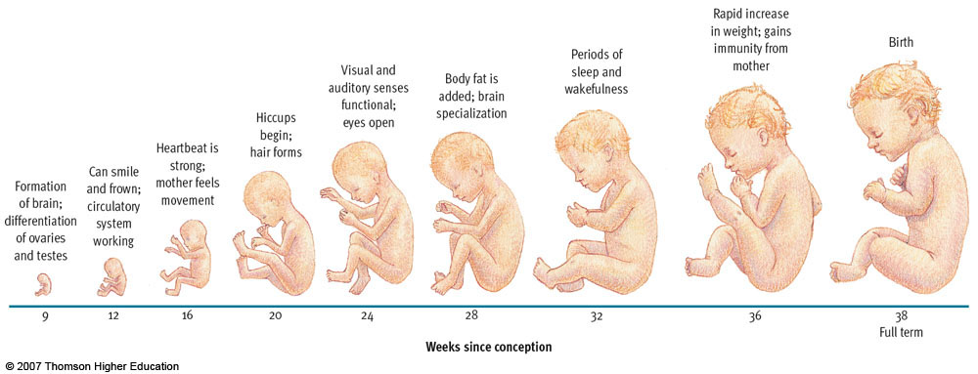
Figure 11.1 Overview of fetal development

Slide 4
Environmental Factors and Prenatal Development
Maternal nutrition
Malnutrition linked to increased risk of birth complications, neurological problems, and psychopathology
Maternal drug use
Tobacco, alcohol, prescription, and recreational drugs
Fetal alcohol syndrome
Notes:
A developing baby and its mother are linked through the placenta, and a mother’s behaviors can affect the baby dramatically.
Severe maternal malnutrition is linked to increased risk of birth complications and neurological problems in the newborn. Moderate maternal malnutrition has been shown to have negative effects for many years after birth. Research links maternal malnutrition to vulnerability, schizophrenia, and other psychiatric disorders in adolescence and early adulthood.
Maternal drug use can significantly impact a developing baby, even if the drugs are legal, like alcohol and cigarettes. Many drugs, both prescription and recreational, are linked to birth defects. Problems can even be caused by some over the counter drugs.
Fetal alcohol syndrome, one of the leading causes of mental retardation, is a collection of congenital (inborn) problems associated with excessive alcohol use during pregnancy. Problems include microcephaly, heart defects, irritability, hyperactivity, and delayed mental and motor development. FAS is also related to increased incidence of depression, suicide, and criminal behavior in adulthood. Many children don’t meet the criteria for a diagnosis of FAS but are still impaired due to their mother’s drinking. While degree of impairment has been shown to be related to the amount of alcohol consumed by a pregnant woman, current studies suggest that even normal social drinking can have enduring negative effects on children, including deficits in IQ, reaction time, motor skills, attention span, and math skills, as well as impulsive, antisocial, and delinquent behavior.

Slide 5
Environmental Factors and Prenatal Development
Maternal illness
Rubella, syphilis, mumps, genital herpes, AIDS, severe influenza
Prenatal health care
Prevention through guidance
Notes:
Maternal illness can also interfere with prenatal development; the nature of the damage depends, in part, on when the mother contracts the illness (this is graphically depicted on the next slide).
Prenatal health care begins early in pregnancy, with a focus on guidance from health professionals. Prenatal care is associated with higher survival rates and reduced prematurity, but many women, because of poverty and other problems, do not receive prenatal care.

Slide 6
The Childhood Years: Motor Development
Basic Principles
Cephalocaudal trend – head to foot
Proximodistal trend – center-outward
Maturation – gradual unfolding of genetic blueprint
Developmental norms – median age
Cultural variations
Notes:
Motor development refers to the progression of muscular coordination required for physical activities.
A basic number of principles are apparent in motor development. The cephalocaudal trend describes the fact that children tend to gain control over the upper part of their bodies before the lower part.
The proximodistal trend describes the fact that children gain control over their torsos before their extremities.
Motor development depends in part on physical growth, as well as on the process of maturation (the gradual unfolding of one’s genetic blueprint), and the infant’s ongoing exploration of the world.
Developmental norms indicate the median age at which individuals display various behaviors and abilities…useful benchmarks only.
Cultural variations in motor development indicate the importance of experience on the development of motor skills. Nevertheless, the similarities across cultures outweigh the differences, illustrating the importance of maturation.

Slide 7
Easy and Difficult Babies: Differences in Temperament
Longitudinal vs. cross-sectional designs
Thomas, Chess, and Birch (1970)
3 basic temperamental styles
easy – 40%
slow-to-warm-up – 15%
difficult – 10%
mixed – 35%
stable over time
Notes:
Cross-sectional studies compare groups of participants of differing age at a single point in time, while longitudinal studies observe one group of participants repeatedly over time.
Cross-sectional studies are easier, quicker, and cheaper; longitudinal designs are more sensitive to developmental influences, however.
Thomas, Chess, and Birch, 1970, were the first to begin a longitudinal study of temperament, an individual’s characteristic mood, activity level, and emotional reactivity.
They found that temperamental individuality is established by about 2-3 months of age, and they identified 3 temperamental styles…easy babies were happy, regular in sleep and eating, adaptable, and not readily upset…slow-to-warm-up children were less cheery, less regular in sleep and eating, and slow adapting to change, with moderate reactivity…difficult children were glum, erratic in sleep and eating, resistant to change, and relatively irritable. Some children exhibited mixtures of all three styles.
Following these children over time indicated that difficult children developed more emotional problems than other children, and temperament was generally stable over time.

Slide 8
Easy and Difficult Babies: Differences in Temperament
Kagan & Snidman (1991)
Inhibited vs. uninhibited temperament
inhibited – 15 - 20%
uninhibited – 25 - 30%
stable over time, genetically based
Notes:
While Thomas and colleagues used parent reports, Jerome Kagan and colleagues relied on direct observations. They characterize infants along the inhibited-uninhibited dimension, with inhibited children exhibiting shyness, timidity, and wariness of the unfamiliar, and uninhibited children exhibiting less restraint with regard to the unfamiliar and little trepidation. Evidence suggests that these characteristics are stable over time and may have a genetic base. Current research shows that children who exhibit an inhibited temperament in their second year of life are more likely to develop problems with anxiety during adolescence.

Slide 9
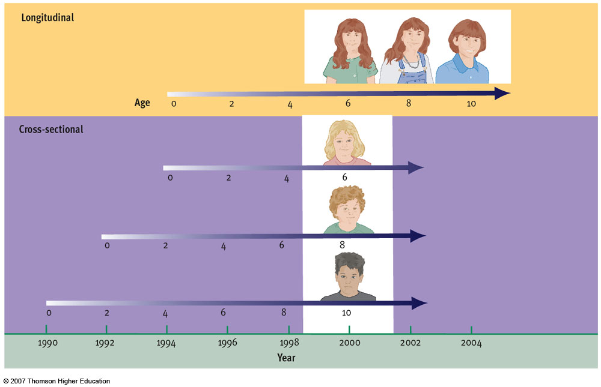
Figure 11.6 Longitudinal versus cross-sectional research

Slide 10
Early Emotional Development: Attachment
Separation anxiety
Ainsworth (1979)
The strange situation and patterns of attachment
Secure
Anxious-ambivalent
Avoidant
Developing secure attachment
Bonding at birth
Daycare
Cultural factors
Notes:
Attachment refers to the close, emotional bonds of affection that develop between infants and their caregivers.
Separation anxiety is emotional distress seen in many infants when they are separated from people with whom they have formed an attachment.
Ainsworth, in the 1970’s, developed a research paradigm to study attachment using separation anxiety as a measure.
She found that most infants have a secure attachment, playing and exploring comfortably when mom is present, becoming visibly upset when she leaves, and calming quickly upon her return.
Some babies, however, show anxiety even when mom is near and protest excessively when she leaves, but are not particularly comforted when she returns…Ainsworth labeled this pattern anxious-ambivalent attachment. Finally, some babies sought little contact with their mothers and were not distressed when she left, a pattern Ainsworth labeled avoidant attachment.
Evidence suggests that securely attached children tend to become resilient, competent toddlers, with high self esteem. In preschool, they show more persistence, curiosity, self-reliance, and leadership…they also get along better with peers. In middle childhood, they display better social skills and have richer friendship networks. Research also suggests that early attachment patterns set the tone for adult romantic relationships.
Factors affecting the development of attachment appear to be related to the quality of interactions between parent and child over time. Bonding during the first few hours after birth does not appear to be crucial to secure attachment. While much concern has focused on the effects of day care on secure attachment, recent research by the NICHD indicates that day care is not harmful to children’s attachment relationships, and there is evidence that there may be beneficial effects of day care on social development in children from deprived backgrounds.
While cross-cultural research shows that attachment is a universal feature of human development, cultural variations in childrearing practices can impact the patterns of attachment seen in a society. Germans, for example, intentionally try to encourage independence, producing more what Ainsworth would call avoidant attachments. Western researchers have demonstrated an ethnocentric slant to their investigations - what represents a secure parent-child attachment may vary culturally.
John Bowlby, who originated the concept of attachment in the late 60s, assumed attachment to be a function of natural selection, with infants programmed to emit behaviors that trigger affectionate, protective responses in adults.
Jay Belsky (1999) asserts that children have been programmed by evolution to respond to sensitive or insensitive care with different attachment patterns.

Slide 11
Stage Theories of Development: Personality
Stage theories, three components
progress through stages in order
progress through stages related to age
major discontinuities in development
Erik Erikson (1963)
Eight stages spanning the lifespan
Psychosocial crises determining balance between opposing polarities in personality
Notes:
Erik Erikson, in the 1960s, proposed a stage theory of personality development based on stages. Many theories of development describe development in terms of stages, or developmental periods during which characteristic patterns of behavior are exhibited and certain capacities become established.
Stage theories assume that individuals must progress through specified stages in a particular order because each stage builds on the previous one. They also assume that progress through the stages is strongly related to age, and that development is marked by major discontinuities that bring about dramatic changes in behavior.
Erikson theorized that there are eight stages, spanning the lifespan, in personality development. He held that there is a specific psychosocial crisis during each stage, the outcome of which determines the balance between opposing polarities in personality.
The eight stages in his theory are depicted on the next slide.

Slide 12
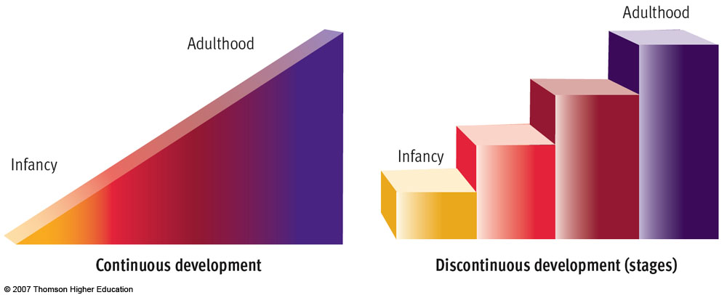
Figure 11.10 Stage theories of development

Slide 13
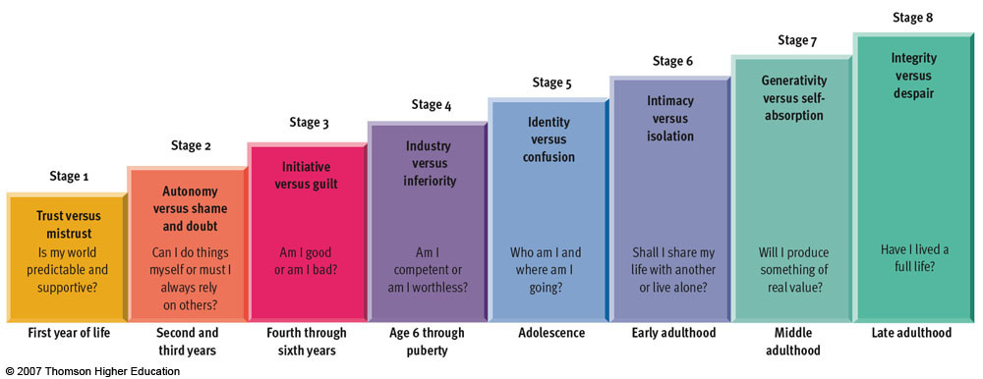
Figure 11.11 Erikson’s stage theory

Slide 14
Stage Theories: Cognitive Development
Jean Piaget (1920s-1980s)
Assimilation/ Accommodation
4 stages and major milestones (Some People Can Fly)
Sensorimotor
Object permanence
Preoperational
Egocentrism
Concrete Operational
Reversibility, Conservation
Formal Operational
Abstraction
Notes:
Jean Piaget made a landmark contribution to psychology’s understanding of cognitive development, asserting that interaction with the environment and maturation gradually alter the way children think. This progression in thinking occurs through the complementary processes of assimilation (interpreting new experiences in terms of existing mental structures without changing them) and accommodation (changing existing mental structures to explain new experiences).
Piaget proposed that children’s thought processes go through a series of four major stages. (These stages, and the age ranges associated with each, are depicted on the next slide).
Within each stage there are characteristic thinking and reasoning patterns, as well as milestones in development.
In the sensorimotor stage, for example, a child progressively develops object permanence, or the recognition that objects continue to exist even when they are no longer visible.
In the preoperational stage, children engage in symbolic thought, with characteristic flaws in their reasoning such as centration, the tendency to focus on just one feature of a problem, and egocentrism, the limited ability to share another’s viewpoint. This results in animism, the belief that all things are living, just like oneself.
The concrete operational stage is characterized by the ability to perform operations with symbolic thought such as reversing or mentally undoing an action. Children in the concrete operational stage are able to focus on more than one feature of a problem simultaneously, a process called decentration. These new cognitive skills lead to conservation, or recognizing that amount of a substance does not change just because appearance is changed.
The formal operational period is marked by the ability to apply operations to abstract concepts such as justice, love, and free will.
The next slide depicts Piaget’s stages, with associated age ranges.

Slide 15
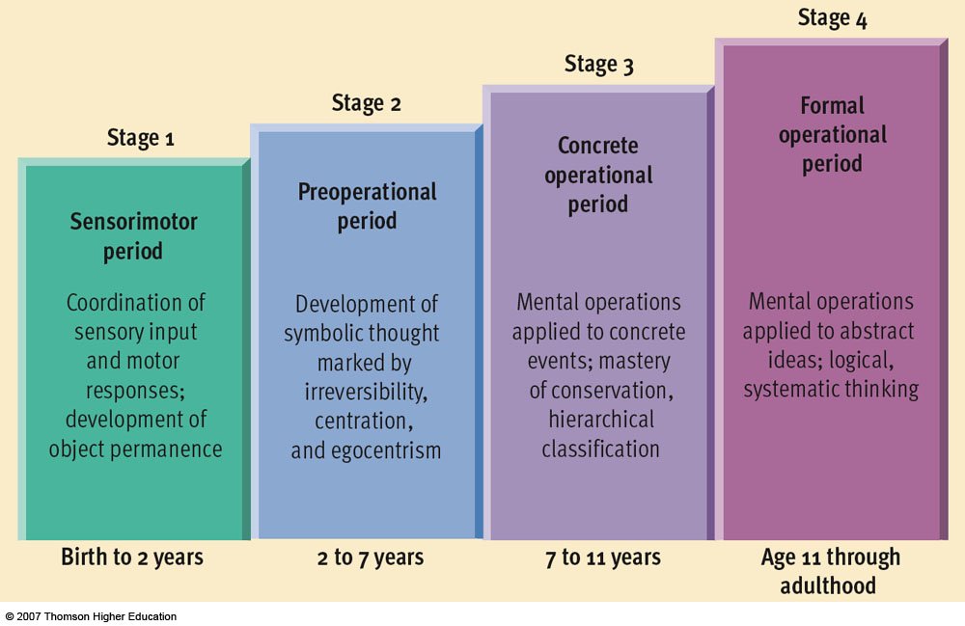
Figure 11.12 Piaget’s stage theory

Slide 16
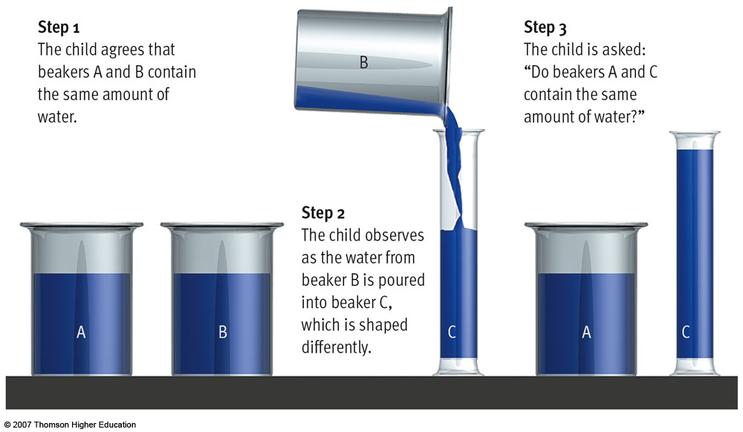
Figure 11.13 Piaget’s conservation task

Slide 17
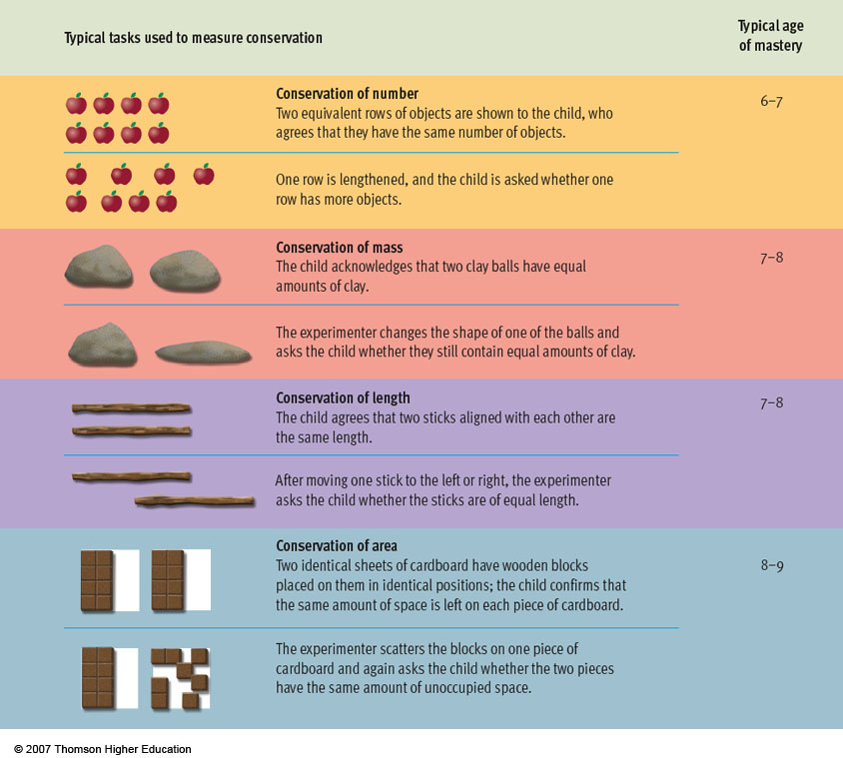
Figure 11.14 The gradual mastery of conservation

Slide 18
The Development of Moral Reasoning
Kohlberg (1976) He theorized that people progress through stages of moral development. Each stage represents a different way of thinking about right and wrong.
Reasoning as opposed to behavior
Moral dilemmas – Heinz dilemma
Measured nature and progression of moral reasoning
3 levels, each with 2 sublevels
Preconventional
Conventional
Postconventional
Notes:
Lawrence Kohlberg devised a stage theory of moral development based on subjects’ responses to presented moral dilemmas. Kohlberg was interested in a person’s reasoning, not necessarily their answer.
He theorized that people progress through a series of three levels of moral development, each of which can be broken into 2 sublevels. Each stage represents a different way of thinking about right and wrong.
These stages, and the characteristic reasoning patterns associated with each, are presented on the next slide.

Slide 19
Kohlberg
In Europe, a woman was about to die of a very special type of cancer. There was a medicine that, according to the doctors, could save her life. It was a type of medicine that had been recently discovered by the city’s pharmacist.
The medicine was expensive to make but the pharmacist charged ten times more than his cost to produce it. Production cost was 200 dollars but the pharmacist charged 2,000 dollars for a small dose.
Heinz, the patient’s husband, asked everyone he knew to lend him money and tried all possible legal means, but he got only 1,000 dollars. He told the pharmacist that his wife was dying and asked him to sell the medicine to him at a low cost or to allow him to pay later.
However, the pharmacist answered him "No, I discovered the drug and I'm going to make money from it." Heinz became desperate and he went into the drugstore and stole the medicine for his wife.

Slide 20
Kohlberg
1. Should Heinz steal the medicine? Why or why not?
2. Is it good or bad that he steal the medicine? Why is it good or bad?
3. Has Heinz a duty or an obligation to steal the medicine? Why or why not?
4. If Heinz did not steal the medicine would he be responsible for his wife death? Why or why not?
5. If Heinz does not love his wife, should he steal the medicine? Does it make any difference, for the purpose of stealing or not stealing, if Heinz does or does not love his wife?
6. Imagine that the person who is dying is not his wife but a stranger. Should Heinz steal the medicine for a stranger? Why or why not?
7. Imagine that it is an animal that is dying. Should Heinz steal the medicine in order to save the life of an animal? Why or why not? What if it was his loving dog?
8. Is it important to do the best in order to save another person’s life? Why or why not?
9. Is Heinz acting against the law for stealing the medicine? Why or why not?
10. Should we do anything within our power in order to obey the law? Why or why not?

Slide 21
Kohlberg
Level 1 Pre-conventional morality
Stage 1 Punishment and obedience stage. The child’s judgments concern avoiding physical discomfort or physical punishment.
Stage 2 Hedonistic stage. The child’s judgments concern gaining physical pleasures and rewards like sweets and cuddles.
Level 2 Conventional morality
Stage 3 good boy/girl stage. The child’s judgments concern psychological rewards such as praise and approval from others.
Stage 4 Law and order stage. The child becomes aware of the wider rules of society so judgments concern obeying those rules in order to avoid psychological punishment such as guilt.
Level 3. Post-conventional morality
• Stage 5 Contracts and legalistic stage. Laws and rules are seen as guidelines which can be applied flexibly. Judgments concern achieving fairness or the greatest good for the greatest number.
• Stage 6 Universal ethical principals stage. People at this stage have developed their own set of moral guidelines which may or may not fit with the law. The person’s judgments concern being true to their own standards, even if this is disapproved of by others.

Slide 22
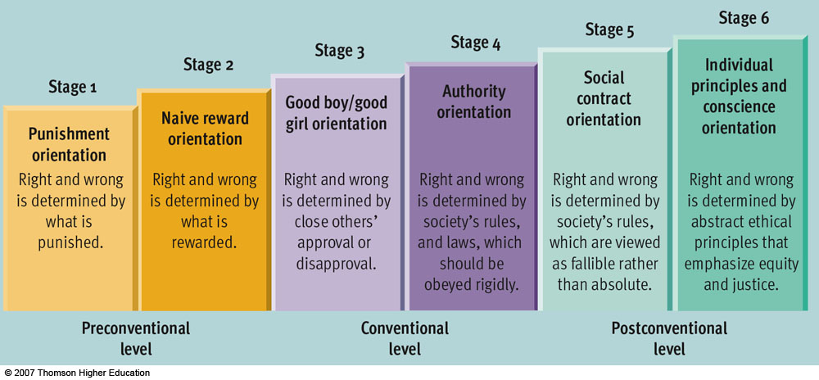
Figure 11.17 Kohlberg’s stage theory

Slide 23
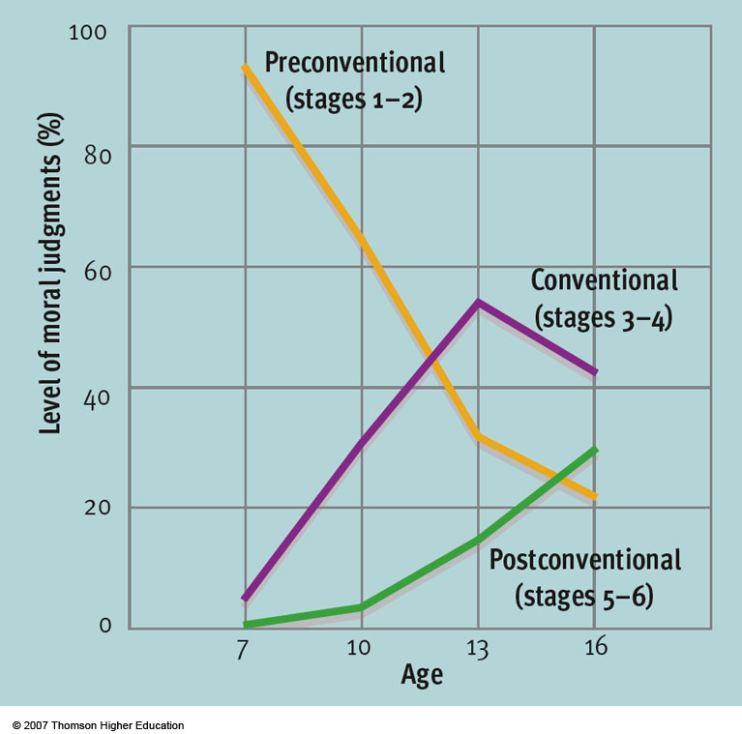

Slide 24
CAROL GILLIGAN
Carol Gilligan was born on November 28, 1936, in New York City.
She has received her doctorate degree in social psychology from Harvard University in 1964 and began teaching at Harvard in 1967.
Then in 1970 she became a research assistant for the great theorist of moral development, Lawrence Kohlberg.
Eventually Gilligan became independent and began to criticize some of Kohlberg' s work. Her opinions were presented in her famous book, " In a different Voice: Psychological Theory and Women ' s Development " which was published in 1982.
She felt that Kohlberg only studied " privileged, white men and boys. " Gilligan said that this caused a biased opinion against women.
Gilligan's goal is was to prove that women are not " moral midgets " , she was going against many psychological opinions.

Slide 27
Adolescence: Physiological Changes
Pubescence - the two-year span preceding puberty during which the changes leading to physical and sexual maturity take place.
Puberty- sexual functions reach maturity, marking the beginning of adolescence. varies (10-15 for girls is typical, 11-16 for boys)
Secondary sex characteristics
Primary sex characteristics
Menarche
Sperm production
Maturation: early vs. late
Sex differences in effects of early maturation
Notes:
Pubescence is the term used to describe During this period, children grow taller and heavier and develop secondary sex characteristics, physical features that distinguish one sex from the other but that are not essential for reproduction.
Puberty is the stage during which sexual functions reach maturity, marking the beginning of adolescence. It is during puberty that the primary sex characteristics, the structures necessary for reproduction, develop fully.
In females, the onset of puberty is signaled by menarche – the fist occurrence of menstruation. In males, it is signaled by sperm production.
Puberty is occurring at younger ages, compared to previous generations; explanations for this trend include improvements in nutrition and medical care. Some theorists (Belsky) also hypothesize that the quality of a person’s early family relationships may influence earlier onset of puberty.
The timing of puberty varies individually (10-15 for girls is typical, 11-16 for boys). Studies of early maturers vs. late maturers indicate that there are sex differences in effects of early vs. late maturation, with early maturing girls and late maturing boys having greater risk for psychological problems and social difficulties.

Slide 28
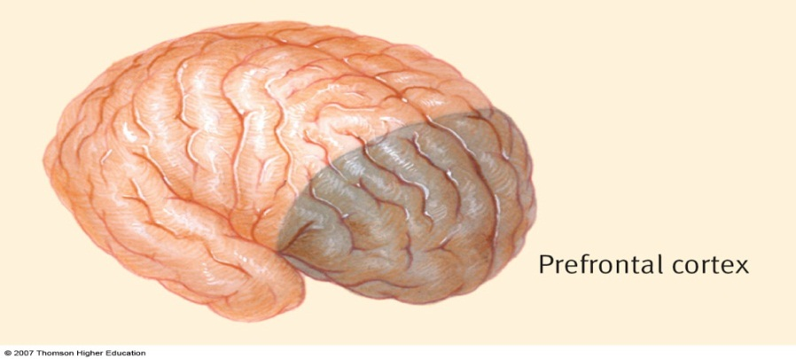
Adolescence: Neural Changes
Increasing myelinization ~ increased conductivity and connectivity
Synaptic pruning ~ less active synaptic elimination
Changes in prefrontal cortex ~ It appears that the prefrontal cortex is the last area of the brain to mature fully. Some researchers have suggested that this is connected with the increase in risky behaviors during adolescence.
Storm and Stress?
Notes:
In recent years, the increasing availability of MRI scans has allowed researchers to study the developing adolescent brain.
The “white matter” increases, reflecting increasing myelinization.
At the same time, there is evidence of increased synaptic pruning.
These changes are thought to reflect maturation in the prefrontal cortex. It appears that the prefrontal cortex is the last area of the brain to mature fully.
Some researchers have suggested that this is connected with the increase in risky behaviors during adolescence.

Slide 29
The Search for Identity “Who am I and where am I going”
Erik Erikson (1968)
Key challenge - forming a sense of identity
James Marcia (1988)
4 identity statuses - not stages…
Diffusion ~ is a state of lack of direction and apathy,
Foreclosure ~ is a premature commitment to a role prescribed by one’s parents.
Moratorium ~ involves delaying commitment and engaging in experimentation with different roles.
Achievement ~ involves arriving at a sense of self and direction after some consideration of alternative possibilities.
Notes:
According to Erikson, the key challenge of adolescence is to form a clear sense of identity.
James Marcia asserts that the presence or absence of crisis and commitment during the identity formation stage can combine in various ways to produce four different identity statuses.
Foreclosure is a premature commitment to a role prescribed by one’s parents.
A moratorium involves delaying commitment and engaging in experimentation with different roles.
Identity diffusion is a state of lack of direction and apathy, where a person does not confront the challenge and commit to an ideology.
Identity achievement involves arriving at a sense of self and direction after some consideration of alternative possibilities.

Slide 30
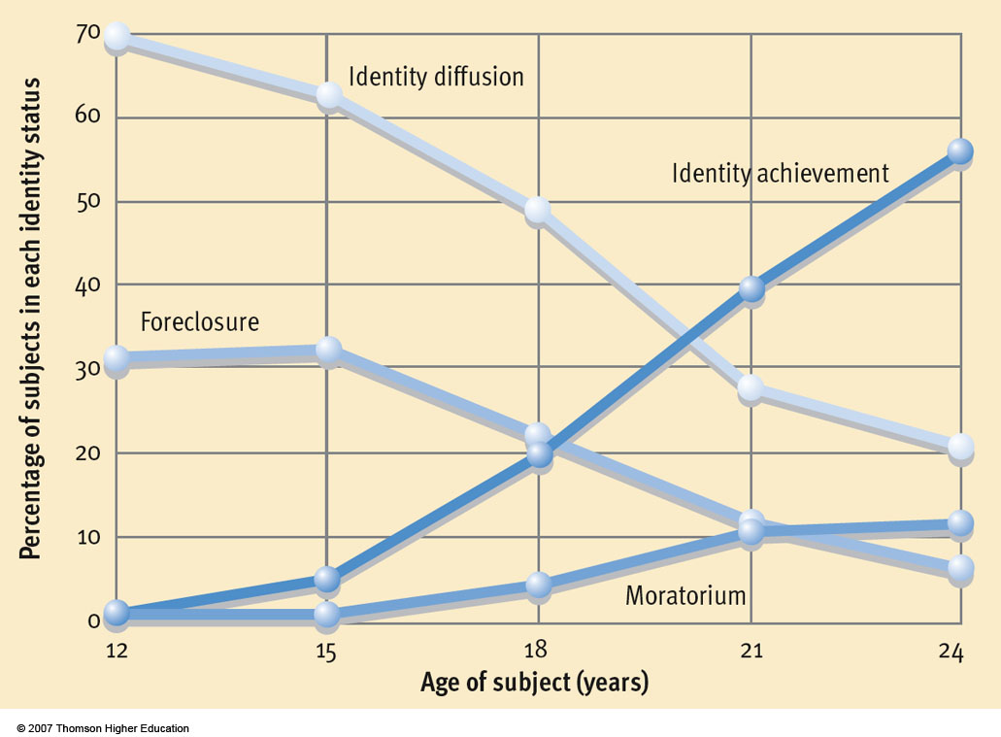

Slide 31
The Expanse of Adulthood
Personality development - marked by both stability and change, adulthood is a period of many transitions. Adults who move successfully through Erikson’s stages develop intimacy, and integrity.
Social development - involve transitions in family relationships: marriage, parenthood, parent adolescent relations, the empty nest syndrome.
Notes:
Personality is Many landmarks in adult development Studies of marriage and marital satisfaction indicate that when spouses have differing role expectations, adjustment to marriage is more difficult. Research also shows highest rates of marital satisfaction at the beginning and end of the family cycle.
Research shows that adjustment to parenthood proceeds more smoothly if unrealistic expectations are not held. Research on later parent/child relations suggests that parent-adolescent relations and the adjustment difficulties that parents may have when children leave home (empty nest syndrome) may not be as stressful as once believed.
Vocational development Age related physical changes include changes in appearance, neuron loss, sensory loss, and hormonal changes. Research indicates that menopause is not as problematic as once thought.
Cognitive functioning research indicates that general mental ability remains fairly stable, with small declines in IQ after age 60. Fluid intelligence is more likely to decline with age, while crystallized intelligence remains stable or increases.
Mental speed declines in late adulthood, and memory losses have been reported in many studies. These are moderate and variable.

Slide 32
The Expanse of Adulthood
Career development - tends to proceed through stages of exploration of careers, establishment of a career, maintenance, and decline.
Physical changes - include changes in appearance, neuron loss, sensory loss, and hormonal changes. Research indicates that menopause is not as problematic as once thought.
Cognitive changes - research indicates that general mental ability remains fairly stable, with very small declines in IQ after age 60.
Notes:
Personality is Many landmarks in adult development Studies of marriage and marital satisfaction indicate that when spouses have differing role expectations, adjustment to marriage is more difficult. Research also shows highest rates of marital satisfaction at the beginning and end of the family cycle.
Research shows that adjustment to parenthood proceeds more smoothly if unrealistic expectations are not held. Research on later parent/child relations suggests that parent-adolescent relations and the adjustment difficulties that parents may have when children leave home (empty nest syndrome) may not be as stressful as once believed.
Vocational development Age related physical changes include changes in appearance, neuron loss, sensory loss, and hormonal changes. Research indicates that menopause is not as problematic as once thought.
Cognitive functioning research indicates that general mental ability remains fairly stable, with small declines in IQ after age 60. Fluid intelligence is more likely to decline with age, while crystallized intelligence remains stable or increases.
Mental speed declines in late adulthood, and memory losses have been reported in many studies. These are moderate and variable.

